Slide 1

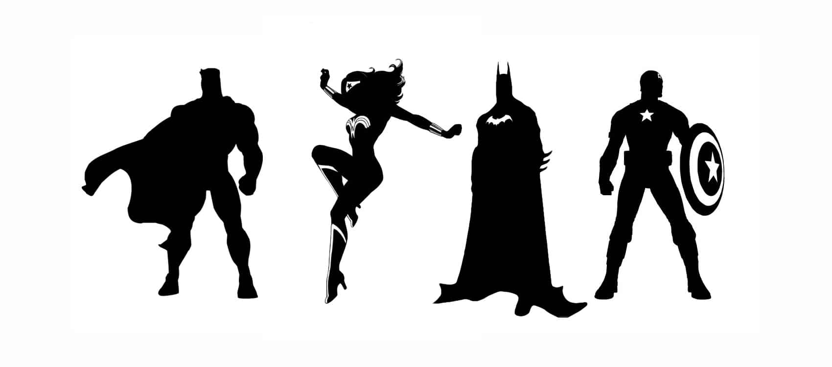
Look of a Superhero
By Sardeep Virk

Slide 2
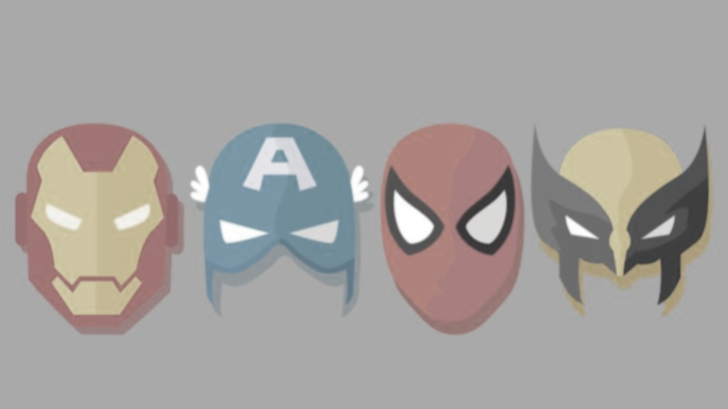
Questions
What does social representation through superheroes look like?
What do superheroes typically look like?
Does appearance impact alignment?
What features are good predictors for superhero alignment?

Slide 3
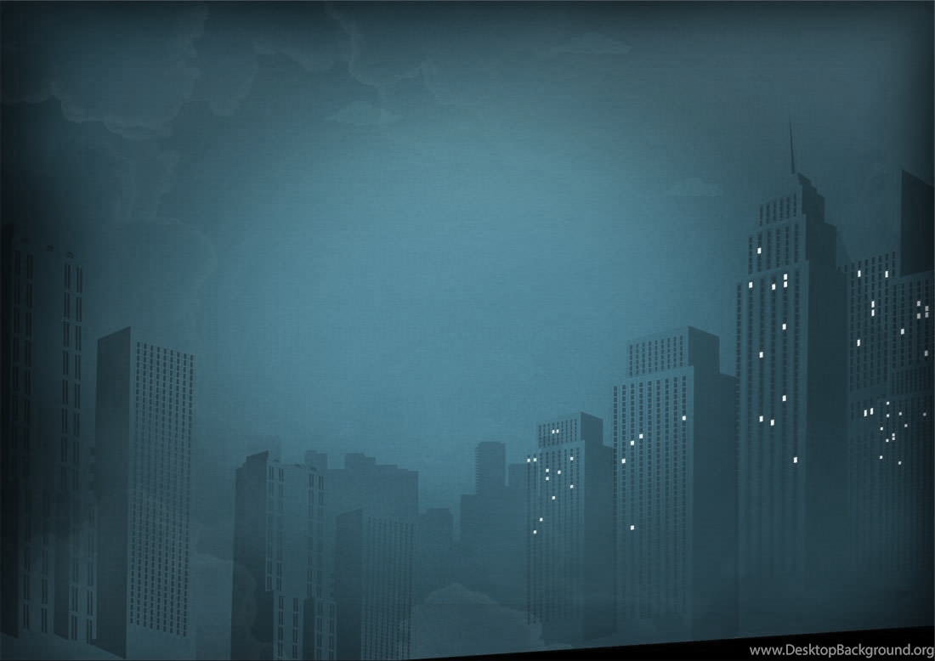
Data Background
Alignment – whether a superhero is good, bad, or neutral. (For the purposed of this study, neutral will be excluded)
Dataset taken from https://www.kaggle.com/claudiodavi/superhero-set/data
Contains 11 features and 734 superheroes
For the purposes of this analysis new features were added through the process of feature creation(height2, weight2, good, bad, hair, and no hair)

Slide 4

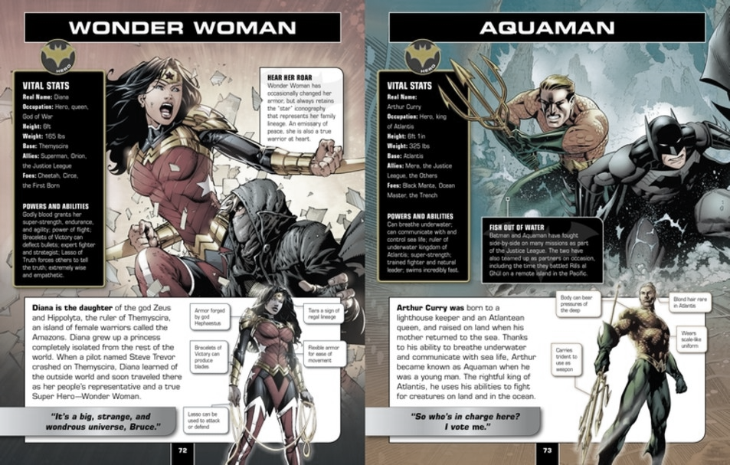
Tested Features
Height(Tall, Short)
Weight(Small, Big)
Hair or No Hair
Gender
Race
Skin Color

Slide 5
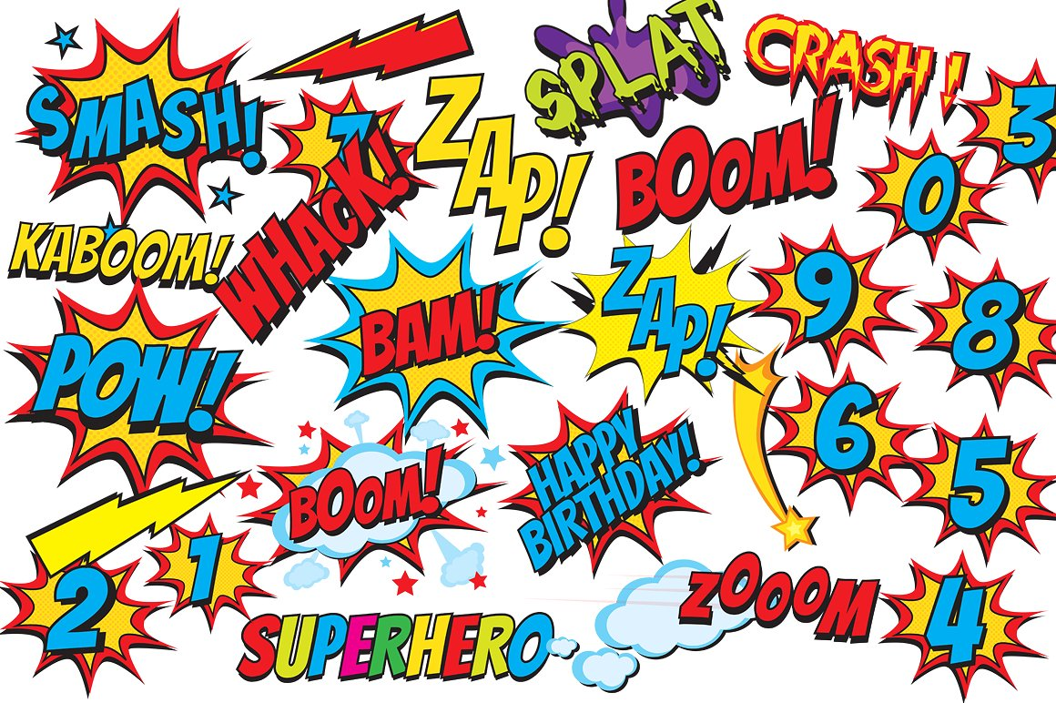
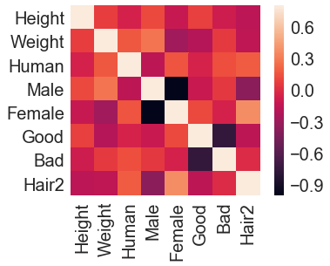
Feature Correlation
Tested Features are independent of one another
Overall, test features are good choices to predict Alignment

Slide 6
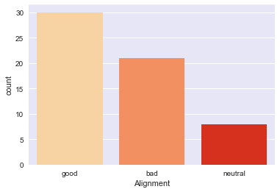
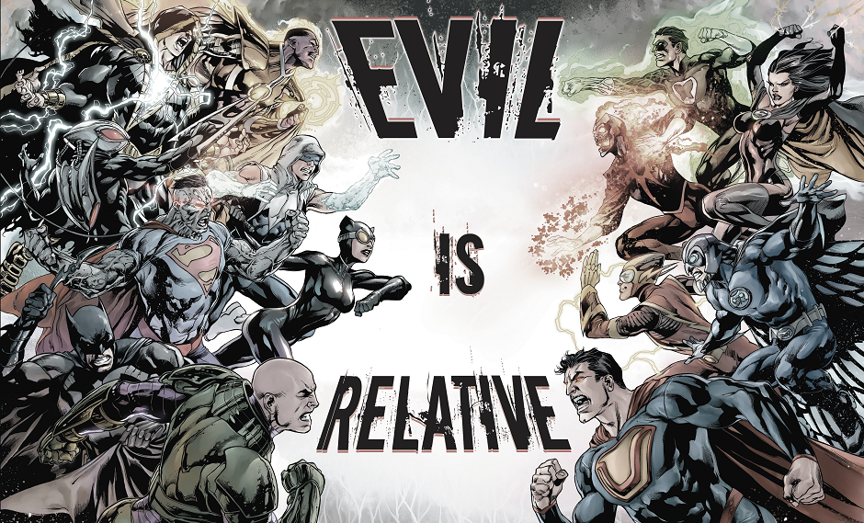
Alignment
Majority of superheroes trend good
For purposes of this analysis only looked at good and bad superheroes

Slide 7
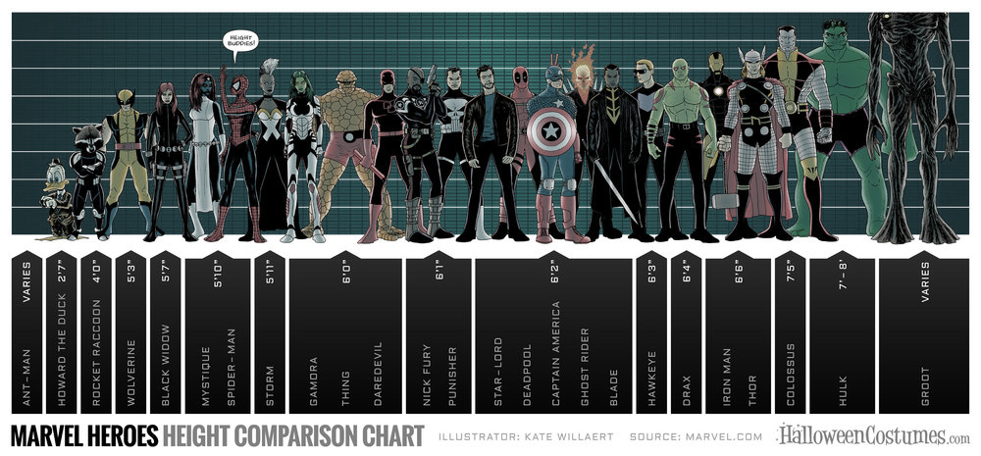
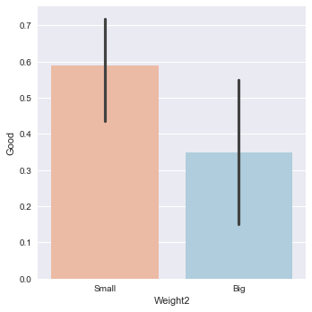
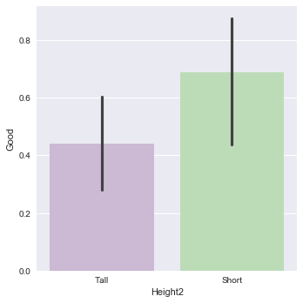
Height & Weight
Superheroes with a small weight and short height trend more likely to be good

Slide 8
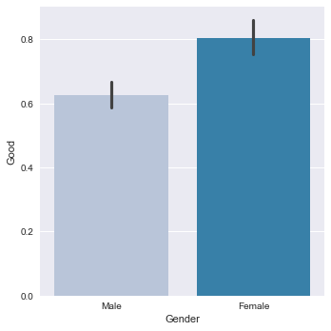
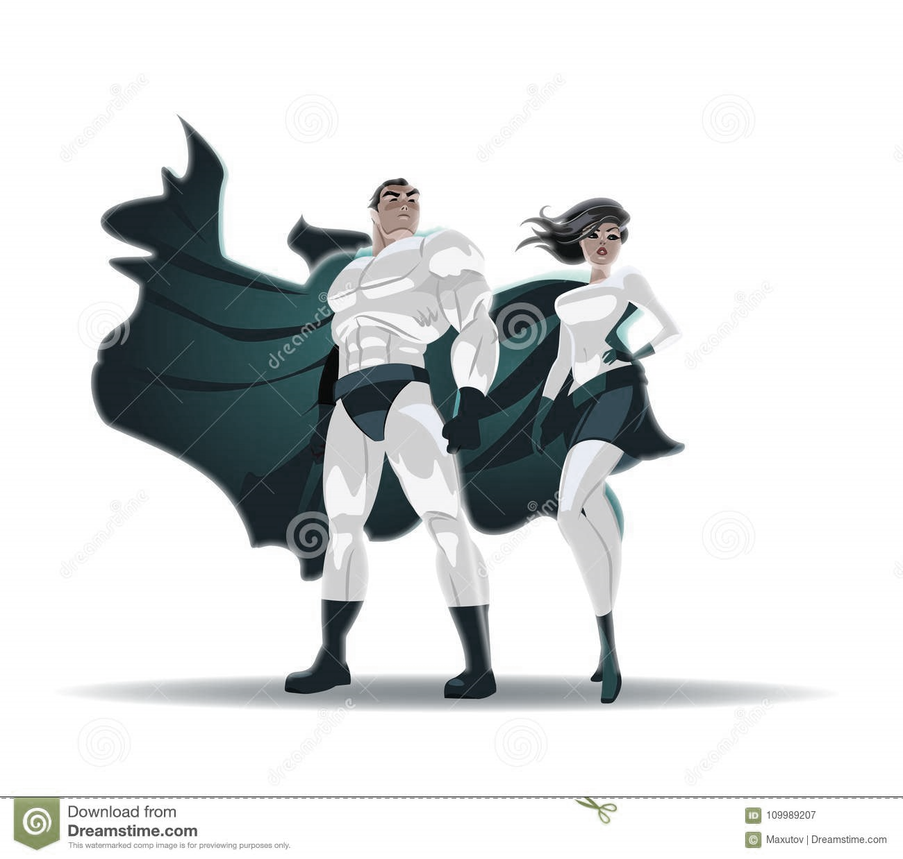
Gender
Females trend more likely to be good than males
There is a greater number of females in the good alignment

Slide 9
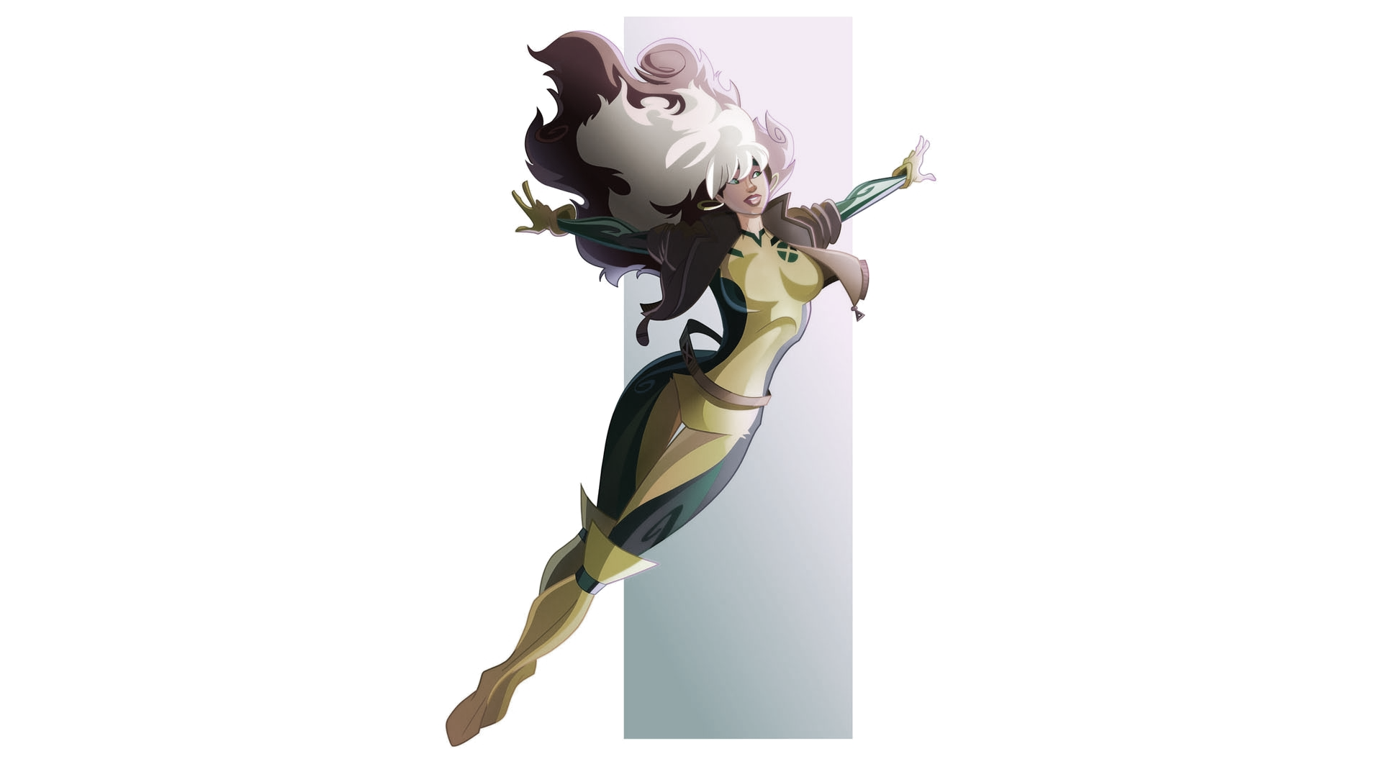
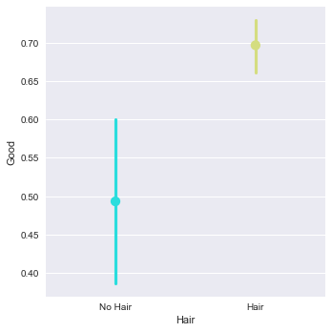
Hair
Having hair is a key indicator for being a good superhero
There is a greater range of superheroes without hair than with hair in the good alignment

Slide 10
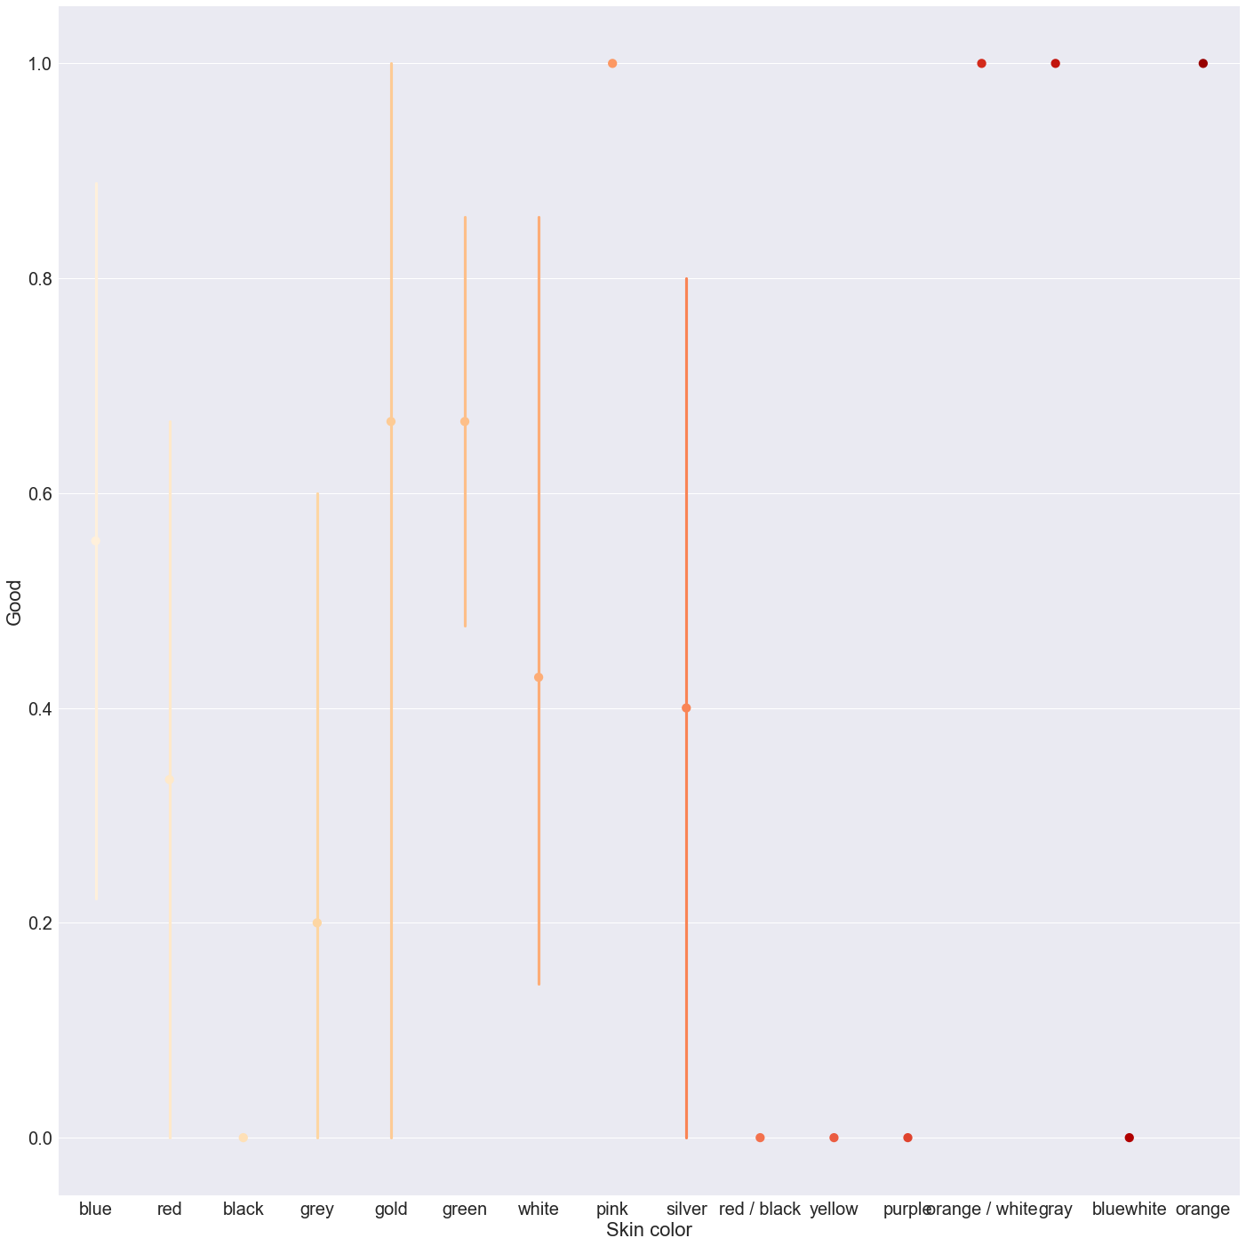
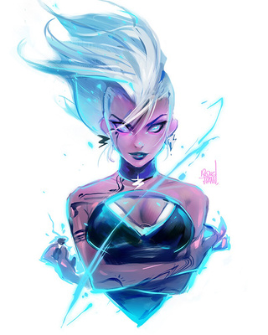
Skin Color
Most notable colors were blue, red, grey, and green since majority of superheroes are these colors.
Grey superheroes illustrate more of a chance in being bad.
Black superhero is likely to align as bad, the n value in only one.

Slide 11
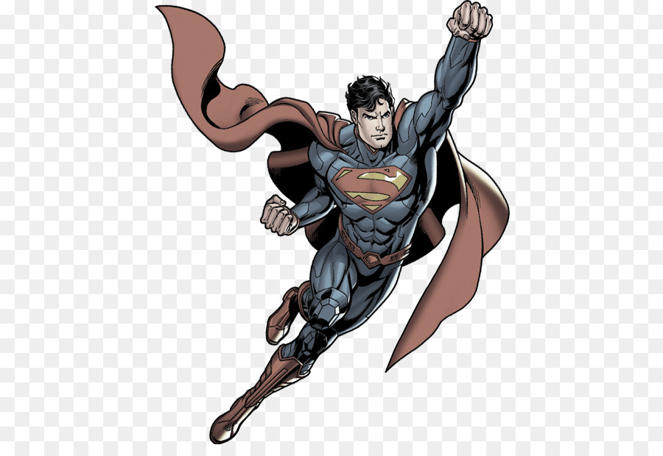
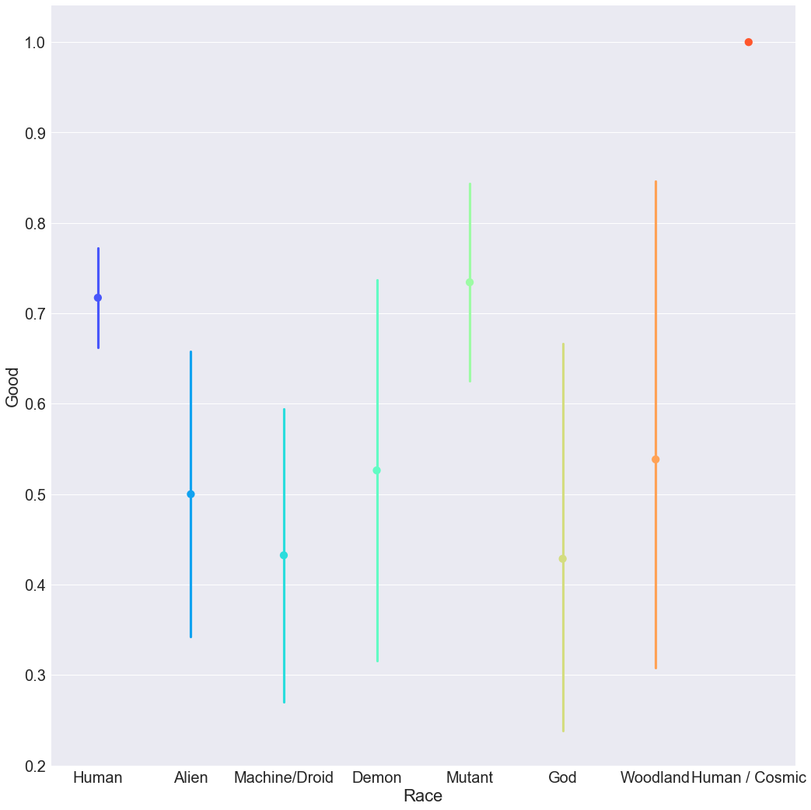
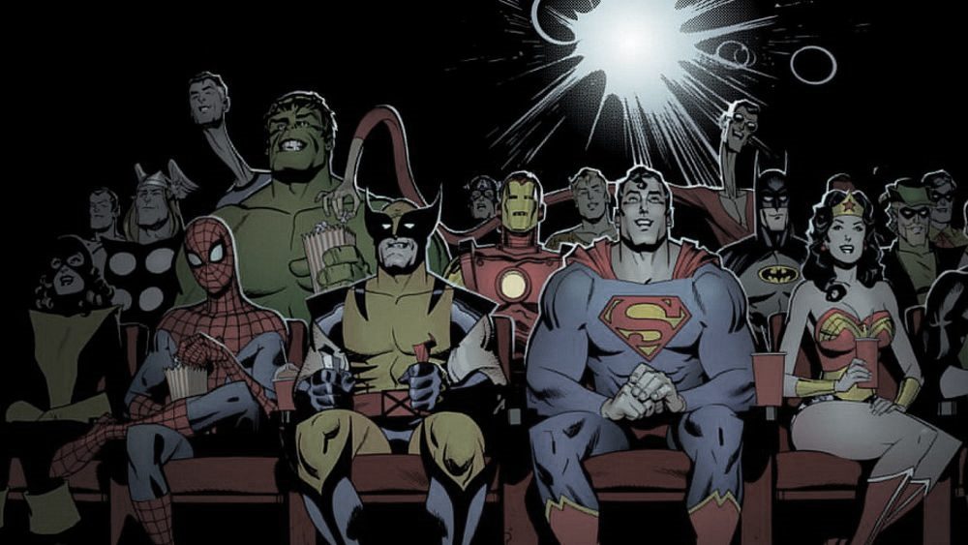
Race
Humans and Mutants trend more likely to be good
Gods and Machine/Droids trend more likely to be bad.
Humans and Mutants possess the smallest range for good alignment

Slide 12
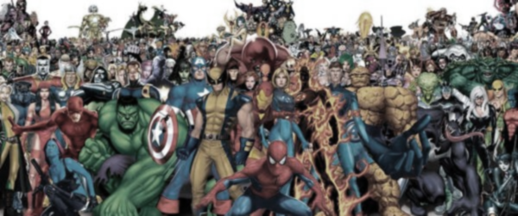
Random Forest
Feature | Importance
Hair_Hair | 0.099285
Skin color_red | 0.062541
Weight2_Small | 0.062228
Hair_No Hair | 0.060636
Skin color_green | 0.053897
Race_Alien | 0.050710
Race_Mutant | 0.047263
X= Gender + Race + Skin color + Hair + Height + Weight
Y= Good
Accuracy = 0.966

Slide 13
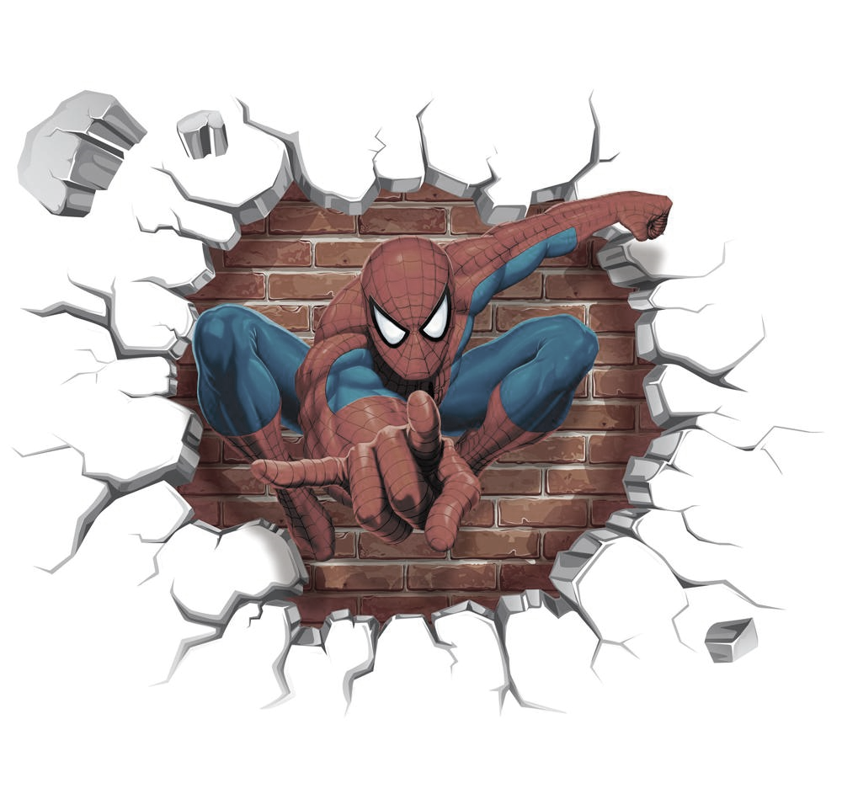
Social Commentary
Hair
Color
According to Global cosmetic industry, hair loss industry profits at $3.6 billion in 2016 and projected to flourish over next five years
In a survey study from Current Medical Research and Opinion, researchers discovered 70% of men associated hair with their image and 62% with their self-esteem
According to Dr. Fields from Psychology Today, color preferences are rooted to emotional responses for humans.
According to Kendra Cherry from VerywellMind, color based purchases linked to what the individual is trying to project:
Red car - bold, power, action, confidence
Grey car – not stand out
Blue car – dependable and trustworthy

Slide 14
Social Commentary
Weight
Race
Found in an article from University of Pittsburg, body image is heavily impacted through media
Men = muscular; be feared
Women = tiny, waif like
Living up to such ideals dangerous for impressionable teens
Boys: at risk by abusing nutritional supplements, being feared possible mental health issues
Girl: at risk of eating disorders(anorexia); websites such as pro-ana nation is bad (thinspiration= bad)
According to Matthew Clair and Jeffery S. Denis, race is understood as a social construct by social scientists
Definition of race evolved over years to include biological differences
Found a segment from The City of University of New York, the concept of the other is of an individual on belonging to the group, is different

Slide 15
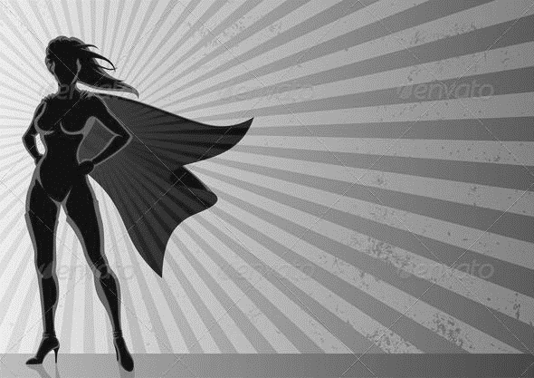
Conclusion
Short and small superheroes trend more likely to be good
Having hair trends good as well
Females trend more likely to be good
Grey spectrum skin colors trend more likely to bad and have a greater range
Human and Mutant races trend more likely to be good
Most import features for prediction good alignment were: hair, skin color, weight, and race
Real world application:
Fighting stereotypes
Looking at beauty norms
Superhero creation

Slide 16
References
(2019, December 19). The US Hair Loss Treatment Industry to Earn $3.6 Billion in 2016. Retrieved from https://www.gcimagazine.com/marketstrends/segments/hair/The-US-Hair-Loss-Treatment-Industry-to-Earn-36-billion-in-2016-407482265.html
R. Douglas Fields PH.D. (2011, April 1). Why We Prefer Certain Colors. Retrieved from https://www.psychologytoday.com/us/blog/the-new-brain/201104/why-we-prefer-certain-colors
Kendra Cherry. (2018, September 26) Color Psychology: Does It Affect How You Feel?. Retrieved from https://www.verywellmind.com/color-psychology-2795824
(2014) Women in Media: Unhealthy and Unattainable Standards. Retrieved from University of Pittsburgh: http://www.wstudies.pitt.edu/blogs/jtf18/women-media-unhealthy-and-unattainable-standards
(2009, February 4) The Other. Retrieved from http://academic.brooklyn.cuny.edu/english/melani/cs6/other.html
Matthew Clair, Jeffrey S. Denis. (2015). Sociology of Racism. Retrieved from https://scholar.harvard.edu/files/matthewclair/files/sociology_of_racism_clairandenis_2015.pdf
Mariola Alfonso, Antonella Tosi, Hertha Richter-Appelt, and Miguel Sanchez Viera. (2005). The psychosocial impact of hair loss among men: A multinational European study. Current Medical Research and Opinion. Retrieved from https://www.researchgate.net/publication/7460640_The_psychosocial_impact_of_hair_loss_among_men_A_multinational_European_study

Slide 17
References
Claudio Davi. (2017). Super Heroes Dataset. Retrieved from Kaggle: https://www.kaggle.com/claudiodavi/superhero-set/home
Superhero Image. Retrieved from https://steamcommunity.com/sharedfiles/filedetails/?id=1468975560
Superhero Image. Retrieved from https://filmschoolrejects.com/51-best-superhero-movies-ever/
Superhero Image. Retrieved from https://www.quora.com/Who-are-some-brunette-female-superheroes
Superhero Image. Retrieved from https://wall.alphacoders.com/big.php?i=478242&lang=Chinese
Superhero Image. Retrieved from https://cals.org/event/superhero-society/2018-11-13/
Superhero Image. Retrieved from https://creativemarket.com/WinchesterLambourne/752933-Superhero-clip-art-comic-book
Superhero Image. Retrieved from http://superheroseries.co.uk/celebrity-superhero/
Superhero Image. Retrieved from https://www.empireonline.com/movies/features/best-superhero-movies-netflix/

Slide 18
References
Superhero Image. Retrieved from https://www.schoolspecialty.com/name-tags-name-plates-1574080
Superhero Image. Retrieved from http://brutalgamer.com/2016/03/31/batman-character-encyclopedia-book-review/
Superhero Image. Retrieved from https://www.dhgate.com/product/super-hero-spider-man-breaking-wall-3d-effect/390294882.html
Superhero Image. Retrieved from https://www.desktopbackground.org/wallpaper/superhero-backgrounds-new-york-party-entertainment-791985
Superhero Image. Retrieved from http://fungyung.com/superheroes-wallpapers.html
Superhero Image. Retrieved from https://www.denofgeek.com/us/books-comics/justice-league/169666/geoff-johns-on-real-villains-behind-trinity-war-and-forever-evil
Superhero Image. Retrieved from https://geektyrant.com/news/marvel-superheroes-height-comparison-chart
Superhero Image. Retrieved from https://www.dreamstime.com/superhero-couple-male-female-superheroes-posing-front-light-isolated-superhero-couple-male-female-superheroes-image109989207
Superhero Image. Retrieved from https://forums.creativecow.net/docs/forums/post.php?forumid=244&postid=865711&univpostid=865711&pview=t

